Slide 1
REFER
A C++ Library

Slide 2
INTRODUCTION
Refer is a C++ library, with the implementation of commonly used and most important Data structures and Algorithms, a compact version of STL (Standard Template Library).
#include “refer.h” will be the main header file that will include all the sub-header files.
Every data structure can be accessed in two ways –
i) including specific data structure header file,
e.g. #include “binarytree.h”
ii) including principal header file, i.e. refer.h
In a similar fashion, algorithms can be accessed.

Slide 3
Data Structures
REFER

Slide 4
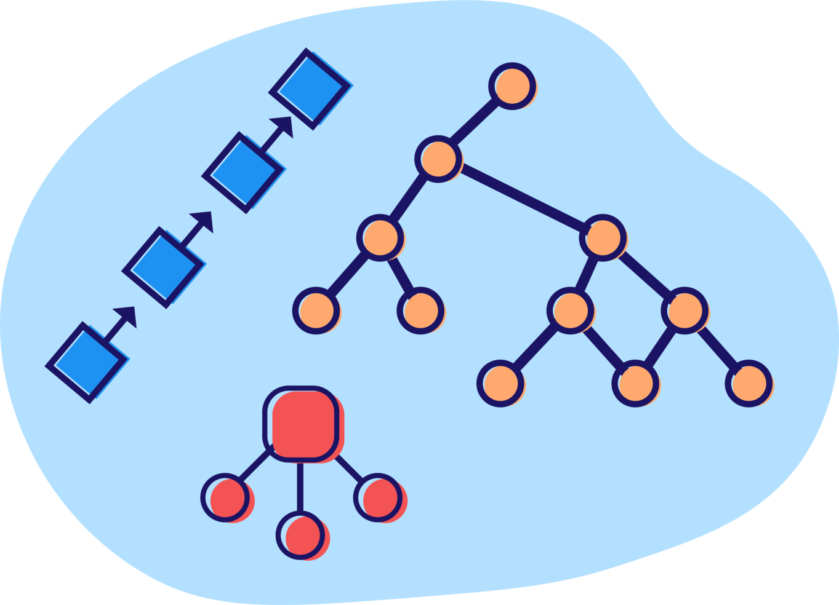
Data Structures
List of data structures
Linked lists (Singly, Doubly, Circular)
Stack
Queue
Priority Queue
HashMap
Set
Trees (k-ary, binary, binary search tree)

Slide 5
Algorithms
REFER

Slide 6

Algorithms
List of algorithms
Sum, Difference, Multiplication, Division
Maximum, Minimum
Print, Print Reverse
Even, Odd, Palindrome
Searching
Sorting
Reverse
Find

Slide 7


Team Members
Raghav Vij
9920103070
Rhythm Shandlya
9920103062
Abhinav Sinha
9920103085

Slide 8
Thank You

